Slide 1
Nidec Automotive Motor Americas
Procedure to Create Connection with Database fro CBM through a User Data Source Name (DSN)
CBM
DATE: February 20,2022

Slide 2
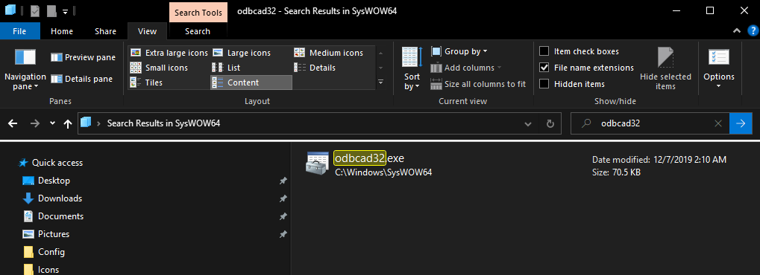
Creating a DSN
Step 1:
Go to C:\Windows\SysWOW64
Search odbcad32.exe
Open it…

Slide 3
Creating a DSN
Step 1: Install Postgres Driver EACR
Go to C:\Windows\SysWOW64
Search odbcad32.exe
Open it…

Slide 4
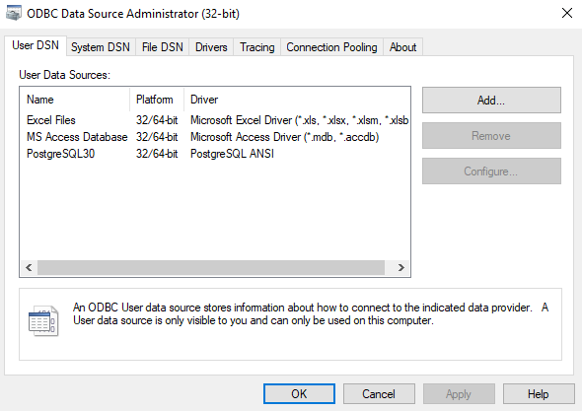
Creating a DSN
Step 2:
A window will pop up
Select User DSN

Slide 5
Creating a DSN
Step 3:
Click Add…

Slide 6
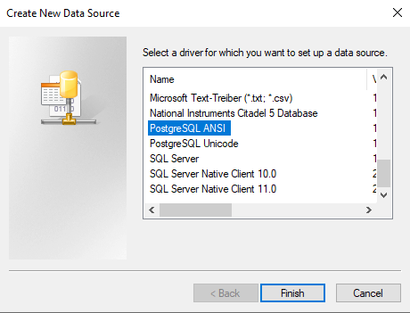
Creating a DSN
Step 4:
Select PostgreSQL ANSI.
Click Finish.

Slide 7
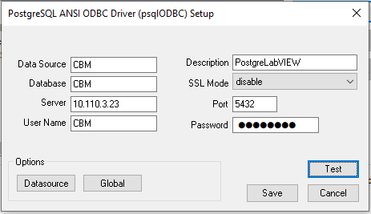
Creating a DSN
Step 5:
Fill the data:
Data Source=CBM
Database=CBM
Server=10.110.3.23
User Name=CBM
Description=PostgreLabVIEW
SSL Mode=disable
Port=5432
Password=Nidec123

Slide 8
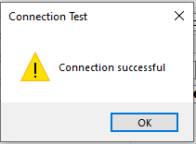
Creating a DSN
Step 6:
Click Test.
Connection must be successful.

